Slide 1
UNIT-2
Technical research paper writing: Methods & style; Seminar & Conference paper writing

Slide 2
What is Technical Research Paper?
A technical paper is a written composition describing, discussing or analyzing a systematic investigation towards increasing the sum of knowledge in a specific field.
It transfers new research and findings to other scientists and researchers
It gives a systematic account of the result of some survey, research, fieldwork and other activities.

Slide 3
Purpose of Technical Paper
Technical paper helps in:
Transferring technical knowledge
Presenting it for future growth
To increase technical knowledge of a specific field

Slide 4
Features of Technical Paper
It is systematic and objective
It aims at three things to inform, to instruct and to persuade
It brings new findings or facts to the knowledge of the people in general
Highly specialized terms are not used in it
It is based on style guides

Slide 5
Elements of Technical Paper
Title
Name of the author
Abstract
Introduction
Methodology
Results/ Findings
Discussion
Conclusion
Appendices
References/ Bibliography

Slide 6
Steps involved in Technical paper writing
Define the Problem
Analyze the Purpose
Make Literature Survey
Analyze and organize the information
Write the First Draft
Review, Revise and Edit
Write the Final Draft

Slide 7
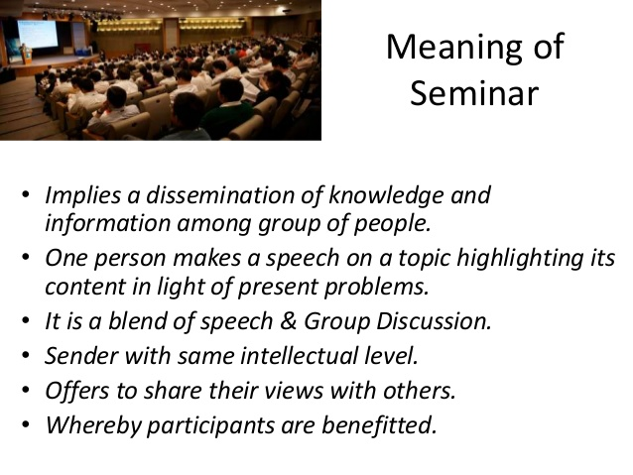

Slide 8
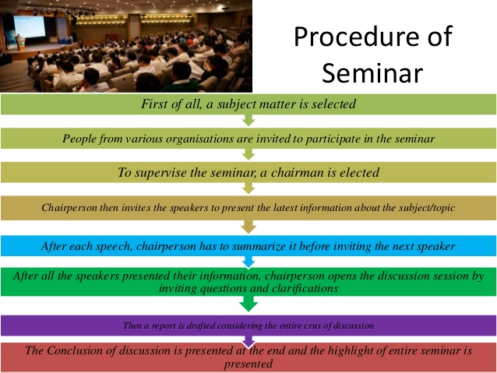

Slide 9


Slide 10
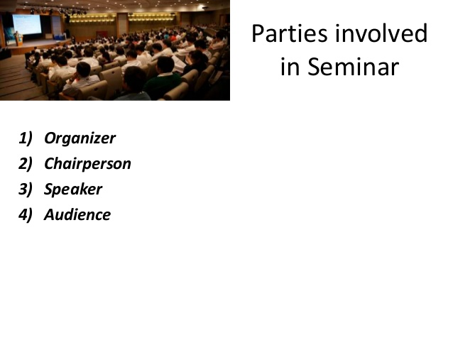

Slide 11
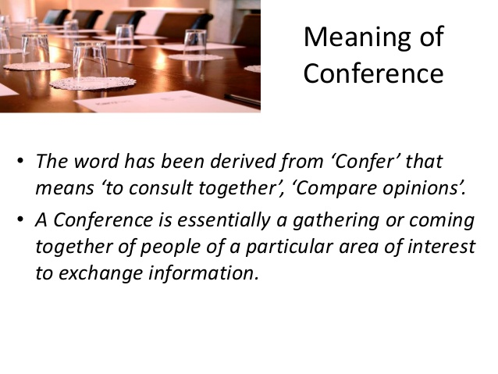

Slide 12
Conference Paper
Conference papers refer to articles that are written with the goal of being accepted to a conference: with a specific scope where you can present your results to the community.
The presentation is usually oral along with a ppt, but initially you have to submit either an abstract or an article which is reviewed by the conference organizers to decide whether or not you get a chance to present at the conference. Often, the paper is later published in the conference proceedings for more visibility.

Slide 13
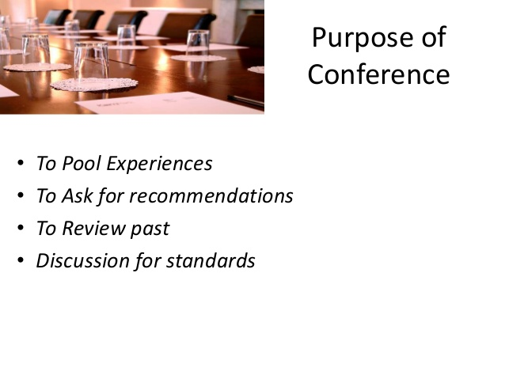

Slide 14
Guidelines for Conference Paper
While writing your conference paper the following format can be referred:
Abstract: It is the first section of the paper and summarizes the findings of your research. You can include the main points of your research like the purpose of your research, the methods used, the findings as well as the conclusion of your research in the abstract.

Slide 15
Guidelines for Conference Paper
Overview and problem statement: It provides a brief overview of your research topic and states the problem that you have identified through your preliminary research. You must highlight a gap between the ideal situation and the reality in this section.

Slide 16
Guidelines for Conference Paper
Proposed method: This section must provide brief details about the methods that you have proposed – the assumptions as well as workings that you have carried out. You can make use of facts and figures to make your data appear impressive.

Slide 17
Guidelines for Conference Paper
Experimental data analysis and results: This section contains a brief analysis of the data and the results of your preliminary experiments.

Slide 18
Guidelines for Conference Paper
Conclusion and References: This section includes the conclusion of your research as well as recommendations for further research. You must also mention all the references correctly in this section.

Slide 19


